Slide 1
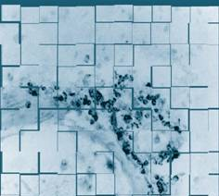
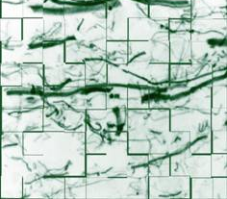
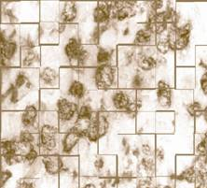
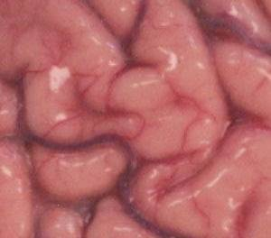
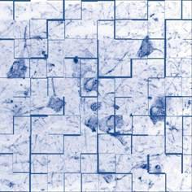
Parkinson’s UK Brain Bank
From Brain to
Breakthrough
Dr George Gverich
Manager
20 November 2023

Slide 2
Coordinated approach…
Donors Relatives
Information
Reporting
Researchers
Tissue supply
Quality assurance
Expertise
PUK Brain Bank
…to fulfilling last wishes
… to facilitating research into cause of Parkinson’s and related conditions
Health Professionals
Education
Parkinson’s UK
Flagship facility Research strategy
Notes:
Tissue Bank has been set up to achieve two major tasks: fulfil last wishes and facilitate research. In regard to its donors the Tissue Bank provides through branch talks and meeting attendance the information about tissue banking, but also a feedback in a form of clinical and neuropathological reports.
Tissue Bank is a flagship facility for the MSS and together with the MRI Unit and the Brain Repair Centre MS Tissue Bank forms a basis for the path leading to clinical discovery and is an important part of a global MS Society strategy to support research into MS

Slide 3
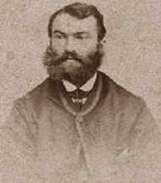
What is Parkinson’s disease?
Parkinson’s, a movement disorder, is the fastest growing neurological condition in the world.
In the UK, around 145,000 people are already living with Parkinson’s.
With population growth and ageing, we estimate that this will increase by a fifth, to around 172,000 people in the UK, by 2030.
Every hour, two more people are diagnosed.
1 in 37 people alive today will be diagnosed with Parkinson’s in their lifetime.
More than 1 million people in the UK are affected.

Slide 4
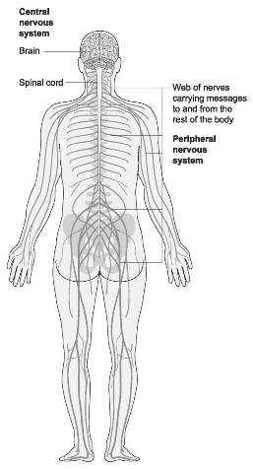
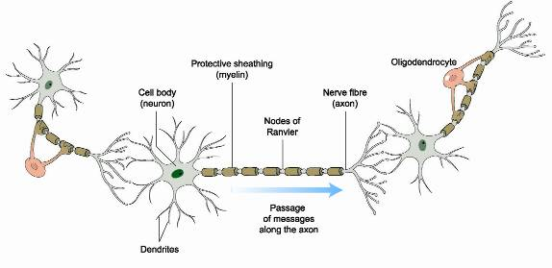
Human nervous system
Processes information from the environment and the body itself
Brain, together with the spinal cord, forms a central nervous system
The brain contains up to 1 billion cells (nerve cells and support cells – glia)

Slide 5
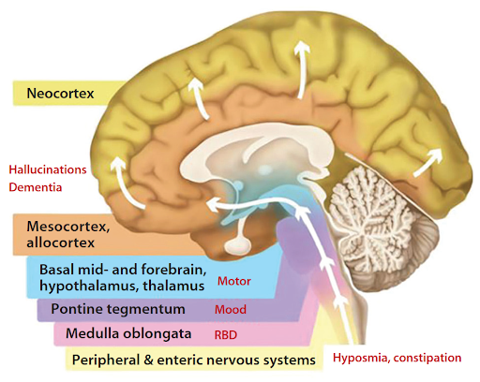
Parkinson’s pathology
Greatly reduced activity of pigmented dopamine-secreting (dopaminergic) cells in the substantia nigra
Inhibition of the direct pathway
which facilitates movement and excitation of the indirect
pathway which inhibits movement
Abnormal accumulation of
the protein alpha-synuclein
bound to ubiquitin (Lewy bodies)
Accumulation of iron, calcium and inhibition of neuromelanin

Slide 6
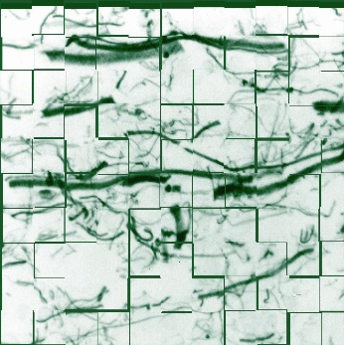
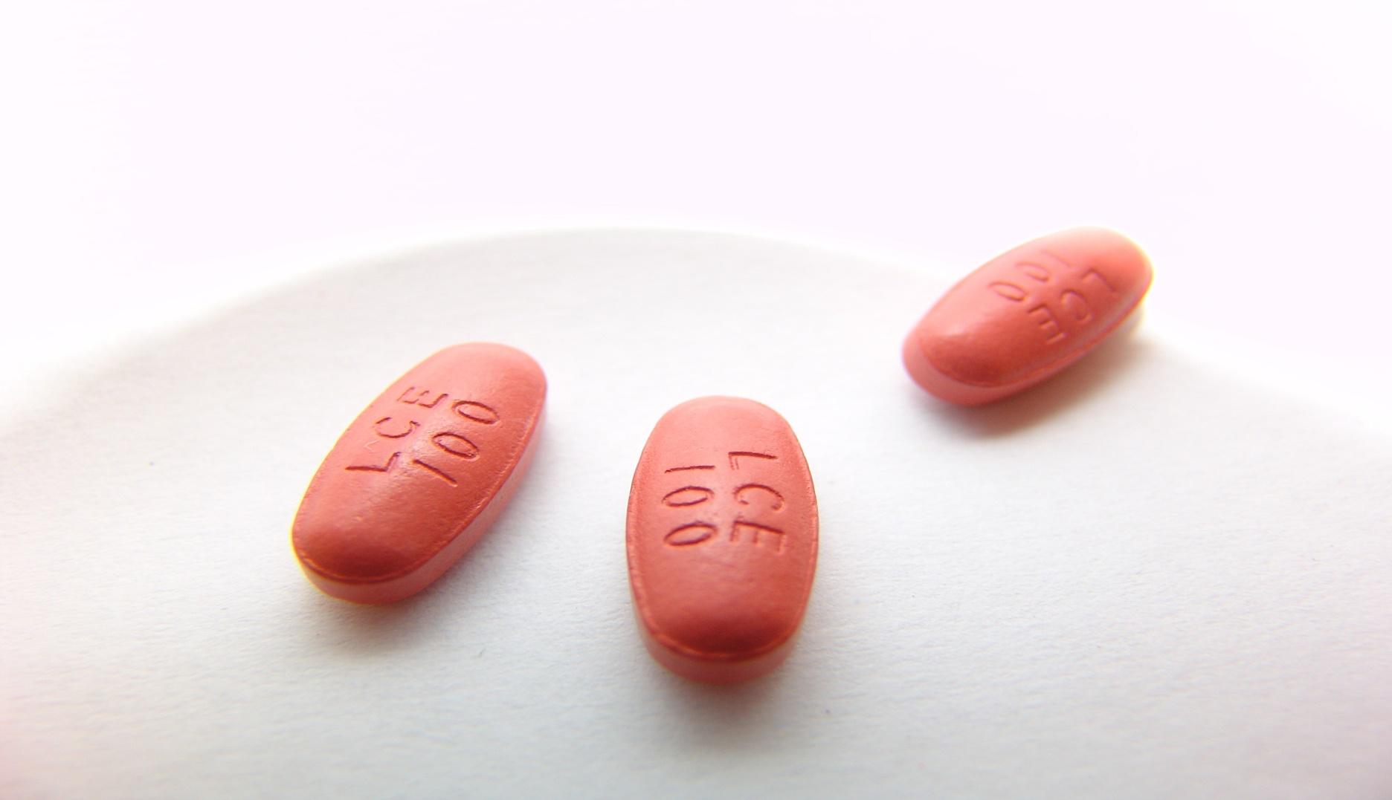
Treatments for PD
Increase the level of dopamine that reaches the brain
Stimulate the parts of the brain where dopamine works
Block the action of other chemicals that affect dopamine (acetylcholine)
Levodopa - a natural amino acid that the brain converts into dopamine
Dopamine agonists - drugs that mimic the effects of dopamine
COMT inhibitors – COM transferase (enzyme) inhibitors (L-Dopa)
MAO-B inhibitors – monoaminooxidase inhibitors (dopamine)
Glutamate antagonist
Anticholinergics

Slide 7
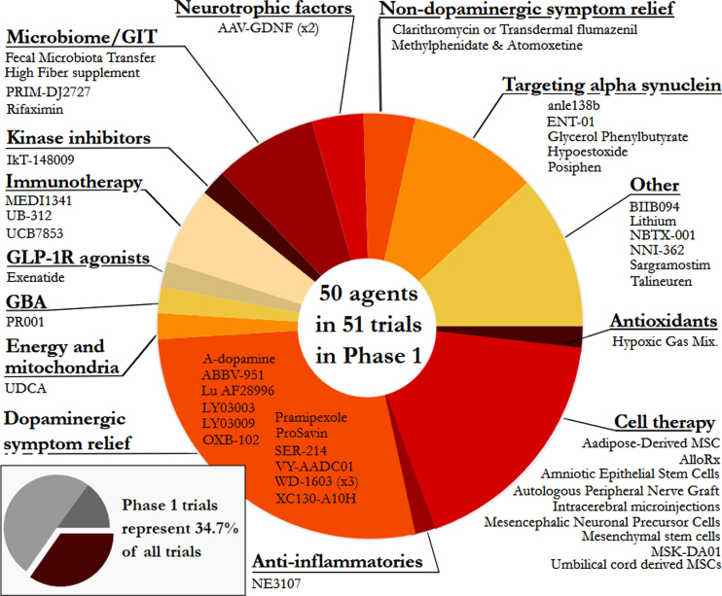
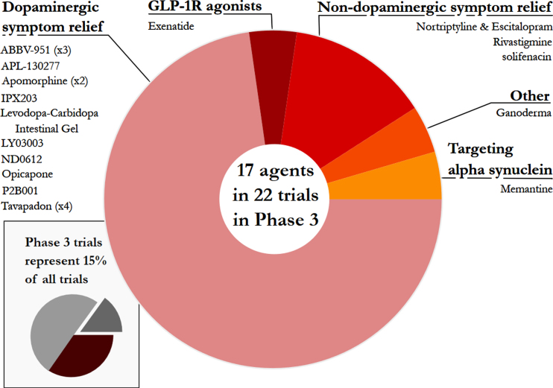
Future therapy

Slide 8
Donor scheme
UK-wide donor scheme
Community-based / no bias
Interacting with major UK PD cohorts
Oxford Discovery
ProBand
PINE

Slide 9
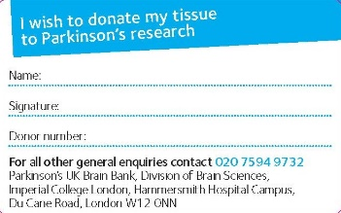
Donor information pack
Who can donate tissue?
Anyone!
Parkinson’s Disease
Parkinson’s plus movement disorders:
Multiple System Atrophy (MSA)
Progressive Supranuclear Palsy (PSP)
Stroke, tumours, CJD, systemic infections
Controls – very important!!!
Information pack contains:
Information booklet
Consent form
Agreement of the next of kin
Health questionnaire
Latest newsletter
Freepost envelope
“DONATION OF YOUR BRAIN IS ONE OF THE MOST IMPORTANT LEGACIES YOU CAN MAKE TO THE ADVANCEMENT OF RESEARCH INTO PARKINSON’S DISEASE!”

Slide 10
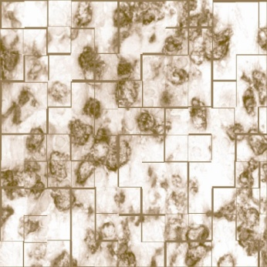
Tissue retrieval
Death of registered donor
Tissue bank informed
07 566 950 965 (24h / 365 days)
Coordinators make all further arrangements
*
The Tissue Bank is organised as a transplant unit and is open 24h a day every day of the year
Death certificate
Administration
*
Mortuary arrangements
Transport
Tissue collection

Slide 11
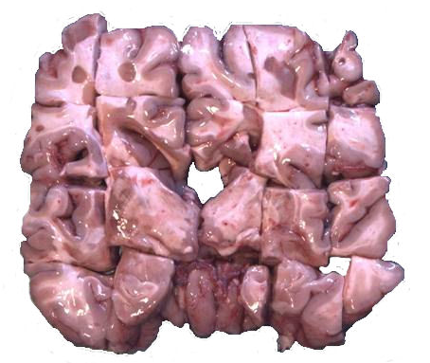
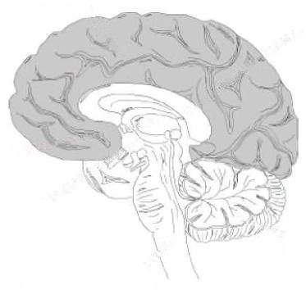
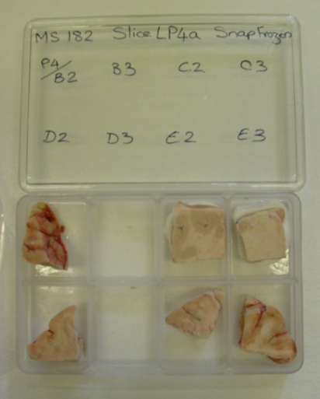
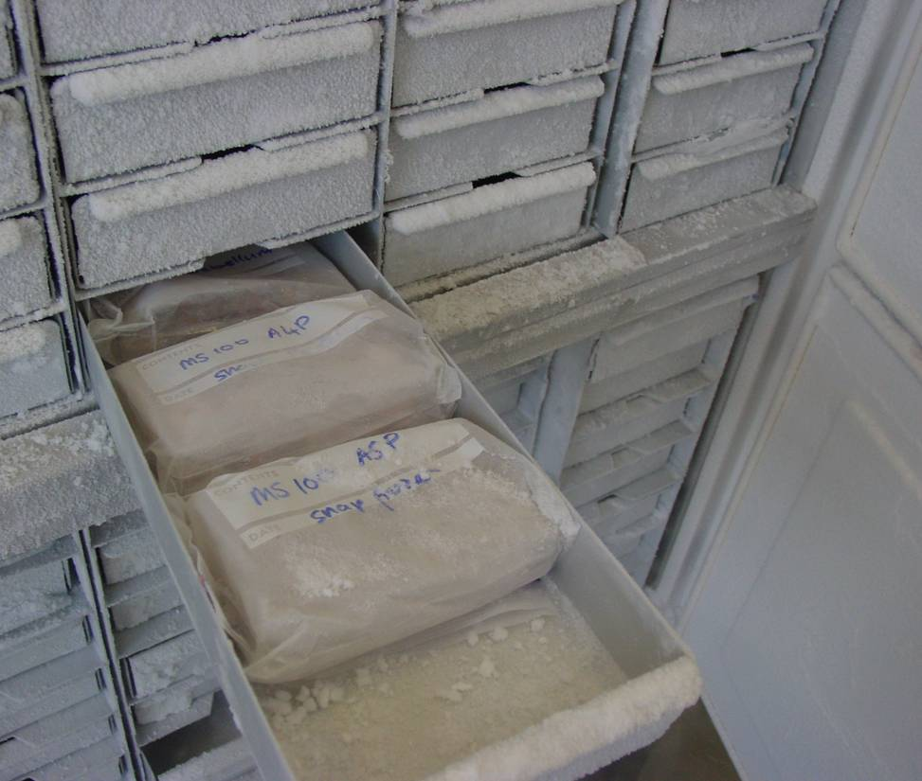
Tissue preparation and storage
1
2
3
4
5
1
2
3
4
5
A
A4
A3
A2
A1
P1
P2
P3
P4
B
C
D
Storage
Coding system (linked anonymisation)
Air-tight containers
Secure freezer banks with controlled access

Slide 12
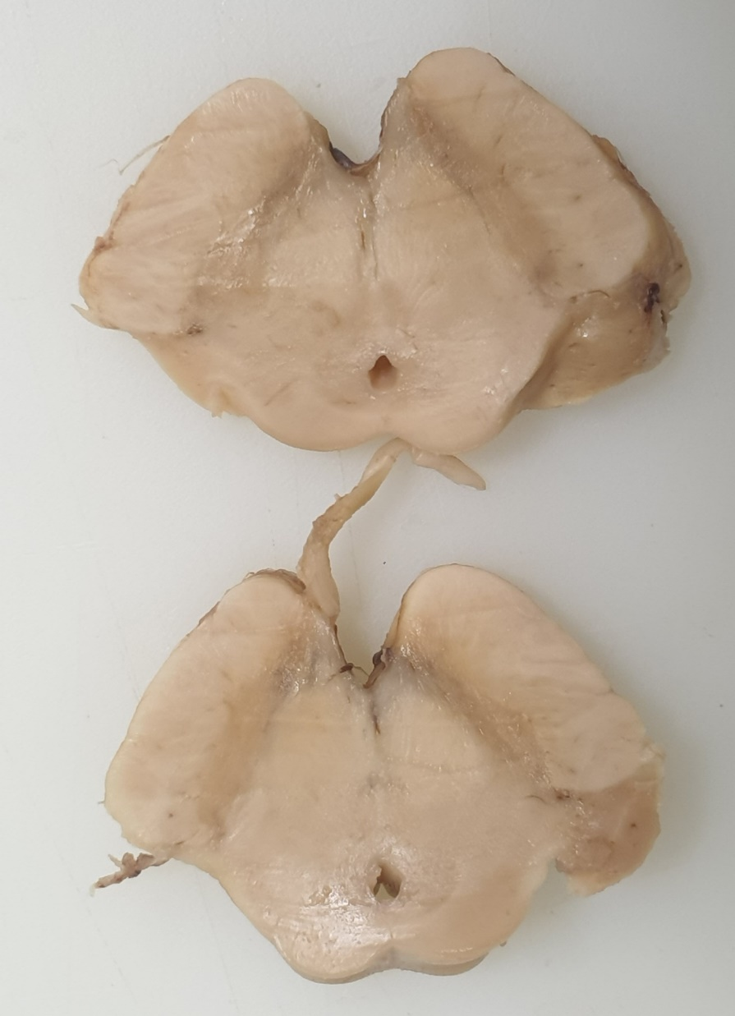
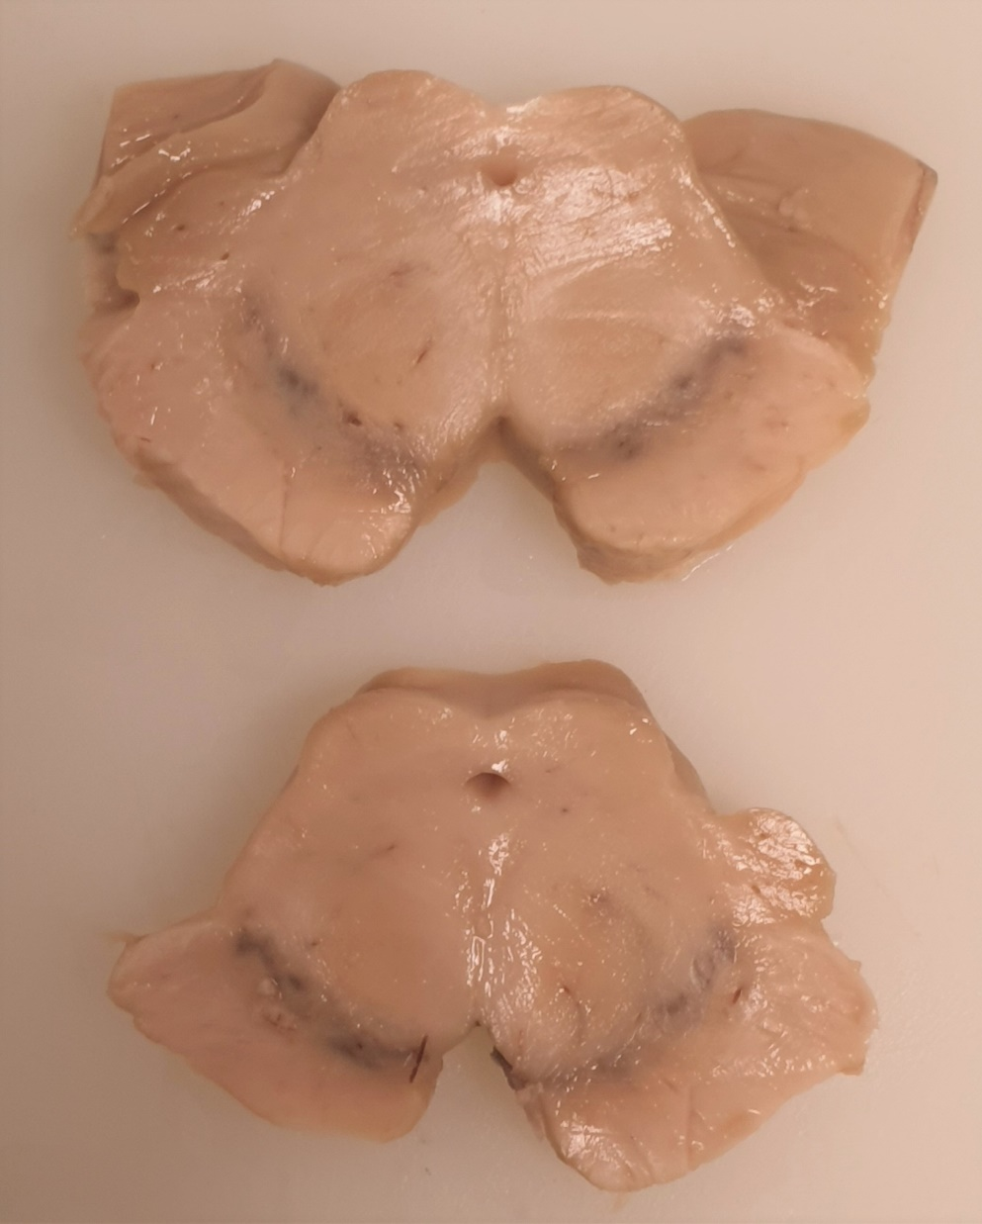
Parkinson’s
Control
Substantia nigra

Slide 13
Tissue preservation and storage
Frozen tissue
PM time <24h
High quality tissue
Life-like
Can be used in any experimental setup even for isolation of live cells
Important for “omics” studies
Genomics
Proteomics
Unfixed tissue
Cell isolation
Generation of cell lines
Fixed tissue
PM time 24-48h
Archival collection (easy storage)
Preferred for pathological and imaging studies

Slide 14
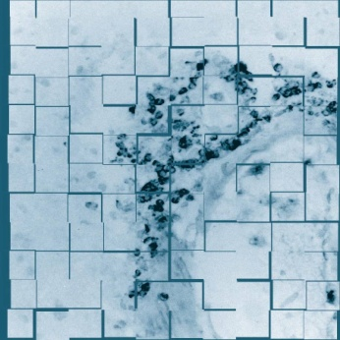
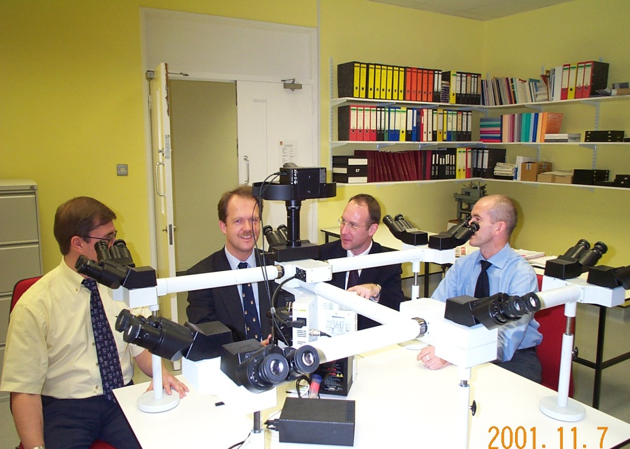
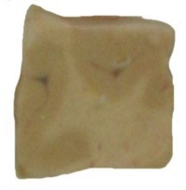
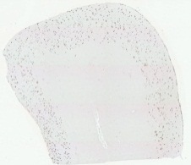
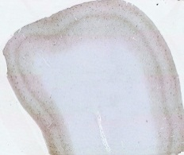
Screening and classification
“Looking at post-mortem brain tissue is like looking at the scene of a crime.
You are trying to gather evidence to find out what has happened!”
Histology dyes and antibodies
10μm sections
α-synuclein
β-amyloid
Tau
H&E

Slide 15
Screening and classification
Clinical diagnosis
From medical records
Idiopathic PD
Vascular PD
DLB
MSA
PSP
Other ND conditions
Neuropathological diagnosis (Lewy body disease)
Confirmation of diagnosis
85% of cases
Braak staging
Synuclein (score 1-6)
Tau (score 1-6)
Braak I – II early PD/incidental PD
pre-symptomatic
Braak III – IV established PD / motor phase
Braak V – VI late PD / dementia
Alzheimer’s and other confounding pathology
ARTAG, LATE, AGD
Pre- and post-mortem variables
Agonal state and hypoxia
Warm ischaemic time
Cold ischaemic time
Tissue pH

Slide 16
The importance of pathology!
Donor 1
Clinical diagnosis: idiopathic Parkinson’s
NP diagnosis: advanced Parkinson’s (LBDN, B6), early Alzheimer's
Donor 2
Clinical diagnosis: idiopathic Parkinson’s
NP diagnosis: mixed dementia (advanced Parkinson’s and advanced Alzheimer’s)
Donor 3
Clinical diagnosis: idiopathic Parkinson’s
NP diagnosis: control - early Alzheimer’s (possible genetic mutation)
Donor 4
Clinical diagnosis: idiopathic Parkinson’s
NP diagnosis: CJD (mad cow disease) and early Alzheimer’s

Slide 17
The importance of data!
The tissue samples are as useful as the data that accompany them
Data collection:
Health questionnaire
Donor lifestyle and medical history questionnaire
Donor follow-up questionnaire
COGNITRON – online cognitive testing https://uktissuebank.cognitron.co.uk/
Parkinson’s register

Slide 18
An internet-based set of Brain Games
Designed to test distinct cognitive abilities and relate them to underlying brain structures
A behavioural-diagnostic tool and a research tool
Over 20 different tests
Great British Intelligence Test study
Trialed for Parkinson’s, MS, and TBI
Over 400k people participated
Notes:
With this in mind, Cognitron, an internet-based behavioural-diagnostic tool already validated in the context of other studies, will be used. Cognitron was developed by Adam Hampshire, Pete Hellyer and Will Trender to test distinct cognitive abilities of users and relate them to underlying brain structures and function ^{9–11}. Cognitron offers a broad range of tasks testing different cognitive domains as well as an extensive amount of control data with which to compare clinical populations.

Slide 19
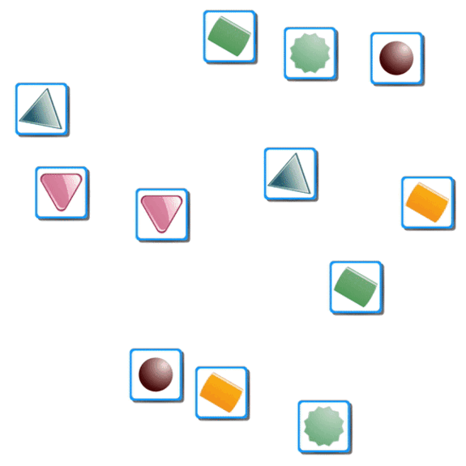
What is cognition?
Card Pairs task
Tests a person’s spatial short-term memory

Slide 20
Example tasks:
Card Pairs task
Tests a person’s spatial short-term memory
Paired-Associations Learning
Tests a person’s capacity for object-location associations

Slide 21
Supporting Research
Tissue Bank has a world-wide exposure
Since 2002 we were contacted by over 500 researchers from North America to Far East asking us to supply tissue for their projects
`
Understand how and why cell death occurs in PD
Develop better treatments for Parkinson’s
Predict and identify possible susceptibility to PD
Prevention

Slide 22
Significance of tissue banking
In vitro studies (in a dish)
In vivo studies (cells and animals)
In silico studies (computers)
Supporting science
Translating results from other systems into human system
Finding valid disease targets disease in humans
Translational research
Target validation
Clinical audit
Providing information for relatives and health professionals

Slide 23
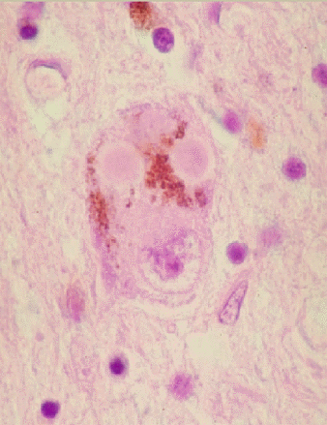
Using tissue for research
More than 500 projects supported UK and worldwide
Understand how and why cell death occurs in PD
Develop better treatments for Parkinson’s
Predict and identify possible susceptibility to PD
Disease prevention

Slide 24
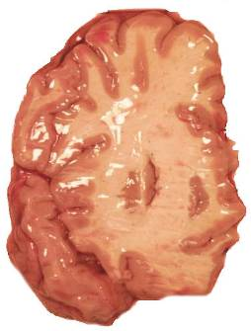
Mechanisms of neuronal death
Neurotoxic components (free radicals, Fe, environmental toxins)
A role of Lewy bodies
Deficiency of the bodies defence systems such as antioxidants
The role of inflammation
Braak staging (spreading of damage)

Slide 25
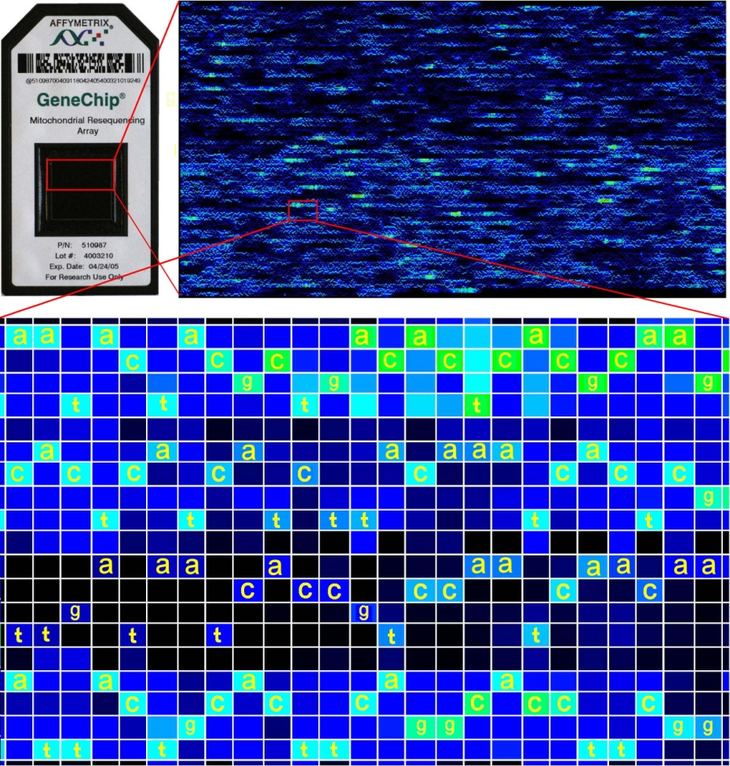
Gene expression analysis
Thousands genes to look at!
Gene expression profiling provides valuable insight into the role of differential gene expression in normal biological and disease processes.
Now identified genes that are either up or down regulated looking at their expression at the cellular level i.e. does it occur in neurones, glia etc…

Slide 26
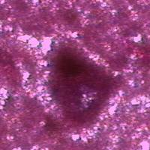
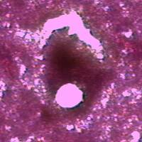
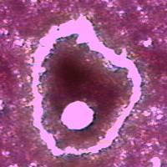
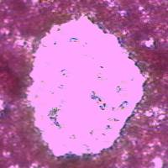
Looking at individual cells
Laser capture microdissection
Selecting a pure sample (single cell)
Transferring sample to a suitable medium
“omics” analysis (genomics/proteomics/connectomics)

Slide 27
How can you help…
Tissue Bank needs more donors
to represent at least 10% of the UK PD population (~140,000)
to include all types of PD and related disorders (PSP, MSA)
to identify potentially interesting genetic cases
to increase number of donation
Demographic/epidemiological data and surveys
tissue bank is not only about death
working with registered donors
Parkinson’s disease samples
blood/saliva/skin samples/DNA/biomarkers
clinical data

Slide 28
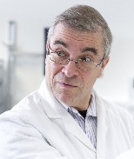
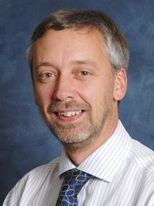
Tissue Bank Team
Directors
Management
Professor Richard Nicholas
Director (MS research)
Dr George Gveric
Manager
Ms Emma Yates
Tissue Bank Coordinator
Professor Steve Gentleman
Director (PD research)
Ms Sashika Selvackadunco
Administrator
Neuropathologists
Technical support
Dr Javier Alegre Abarrategui
Prof. Johannes Attems
Prof. Federico Roncaroli
Marcia Teixeira Curtinha
Marta Garcia Camba
Alayna Jordan
TBA

Slide 29
Visit us!
Brain Bank visits
An excellent opportunity for all those interested in inner workings of a tissue bank or Parkinson’s research in general to find out more from those actually working with human tissue
Starts 10 a.m.
Short presentation by the Tissue Bank Manager
Time for questions/discussion
Tour of the Tissue Bank
Lasting approximately 1h 30min.

Slide 30
Parkinson’s Disease Tissue Bank
From Brain to
Breakthrough
Dr. George Gveric
Manager
20 November 2023

